Slide 1
D3.js Introduction
Tiago Araújo

Slide 2
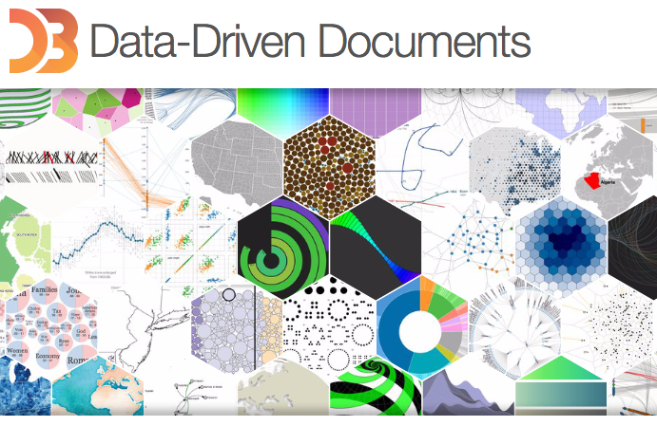
D3 – Data Driven Documents
D3: Data Driven Documents

Slide 3
D3 – Data Driven Documents
Visualization requires visual encoding: mapping data to visual elements.
The HTML Document Object Model has a rich set of features and standards for visual display
A tool not to replace the web and modern browser’s toolbox, but exposes it a easy way to use.

Slide 4
D3 – Data Driven Documents
D3 do not provide representation, it allows transformation of the HTML DOM from text document to Visualization
D3 helps you maintain the mapping of the data points to DOM elements, update and interact with them

Slide 5
D3 – Web Standards
“Learning D3” is largely learning web standards.
The Document refers to the
W3C Document Object Model
Unlike Processing or Protovis, D3’s vocabulary of graphical marks comes directly from web standards: HTML, SVG, and CSS.

Slide 6
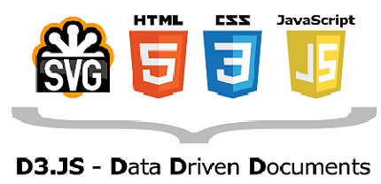

Slide 7
D3 - Library
D3 allows you to bind arbitrary data to a Document Object Model (DOM), and then apply data-driven transformations to the document.
D3 isn’t a monolithic framework; it’s a suite of small modules (31) for data analysis and visualization.

Slide 8
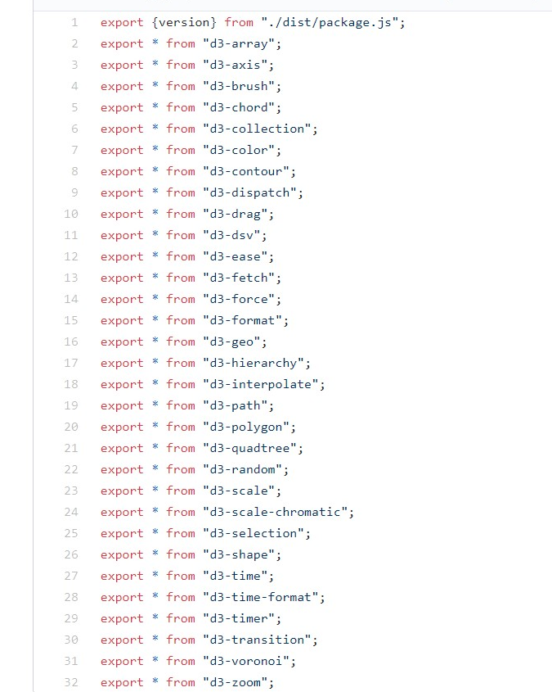
D3 - Library

Slide 9
D3 - Resources
https://bost.ocks.org/mike/d3/workshop/#0
https://blockbuilder.org/
https://observablehq.com/
https://github.com/wbkd/awesome-d3
https://github.com/d3/d3/wiki/Gallery
https://d3-discovery.net/
https://observablehq.com/@d3/

